Slide 1
Implementing Binary -to -Gray, Gray -to -Binary code conversions.

Slide 2
What is Gray Code
Gray code – also known as Cyclic Code, Reflected Binary Code (RBC), Reflected Binary (RB) or Grey code – is defined as an ordering of the binary number system such that each incremental value can only differ by one bit.
In gray code, while traversing from one step to another step only one bit in the code group changes. That is to say that two adjacent code numbers differ from each other by only one bit.
Gray code is the most popular of the unit distance codes, but it is not suitable for arithmetic operations.
Gray code has some applications in analog to digital converters, as well as being used for error correction in digital communication.

Slide 3
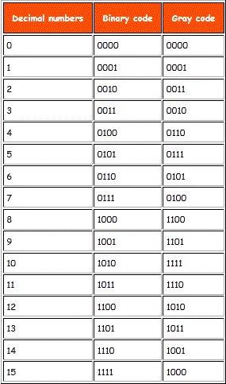
Gray Code Table
A table showing the conversion between binary code to gray code and decimal to gray code is shown here.

Slide 4
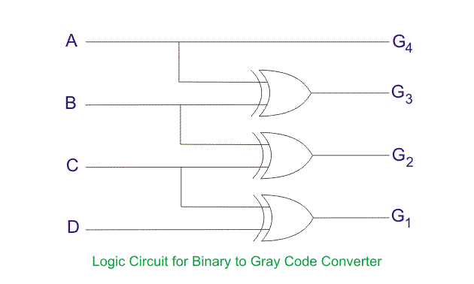
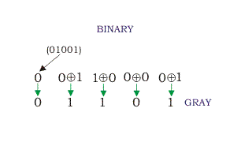
Binary to Gray Code Converter
The logical circuit which converts the binary code to equivalent gray code is known as binary to gray code converter.
An n-bit gray code can be obtained by reflecting an n-1 bit code about an axis after 2^{n-1} rows and putting the MSB (Most Significant Bit) of 0 above the axis and the MSB of 1 below the axis.

Slide 5
How to Convert Binary to Gray Code
The MSB (Most Significant Bit) of the gray code will be exactly equal to the first bit of the given binary number.
The second bit of the code will be exclusive-or (XOR) of the first and second bit of the given binary number, i.e if both the bits are same the result will be 0 and if they are different the result will be 1.
The third bit of gray code will be equal to the exclusive-or (XOR) of the second and third bit of the given binary number. Thus the binary to gray code conversion goes on.

Slide 6
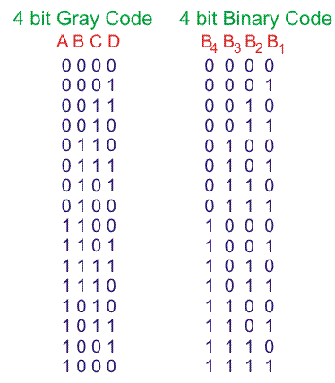
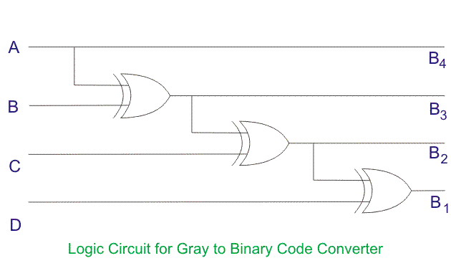
Gray to Binary Code Converter
In a gray to binary code converter, the input is gray code and output is its equivalent binary code.
Let us consider a 4 bit gray to binary code converter. To design a 4 bit gray to binary code converter, we first have to draw a gray code conversion table, as shown below

Slide 7
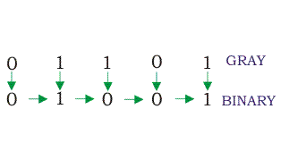
Gray to Binary Code Conversion
The MSB of the binary number will be equal to the MSB of the given gray code.
Now if the second gray bit is 0, then the second binary bit will be the same as the previous or the first bit. If the gray bit is 1 the second binary bit will alter. If it was 1 it will be 0 and if it was 0 it will be 1.
This step is continued for all the bits to do Gray code to binary conversion.

